Slide 1
Honeywell Powder Amplifier
ME486C
Team 29
Midpoint Presentation
Savana Bezdicek, Nicole Mitich, Luke Plumb, Isaac Romero, and Jacob Setzer

Slide 2
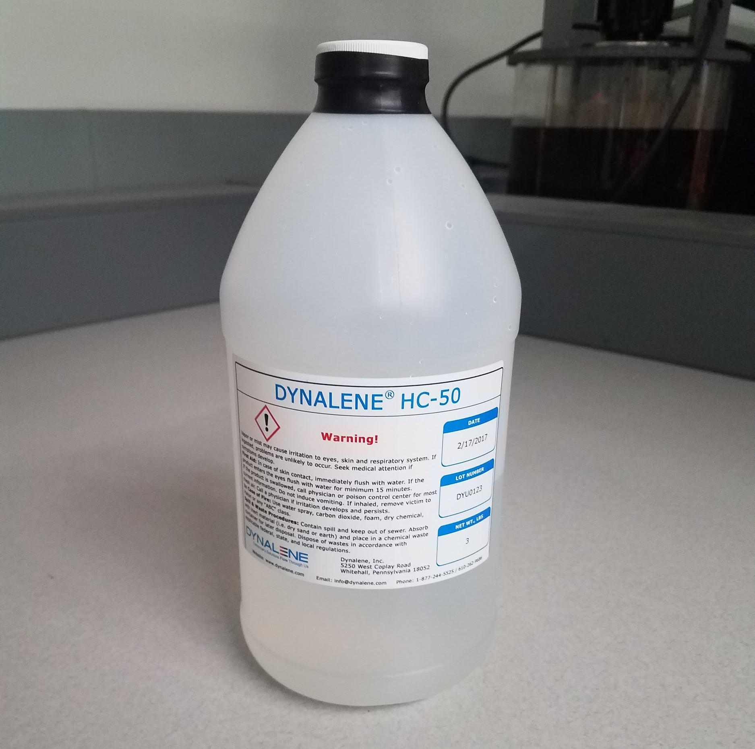
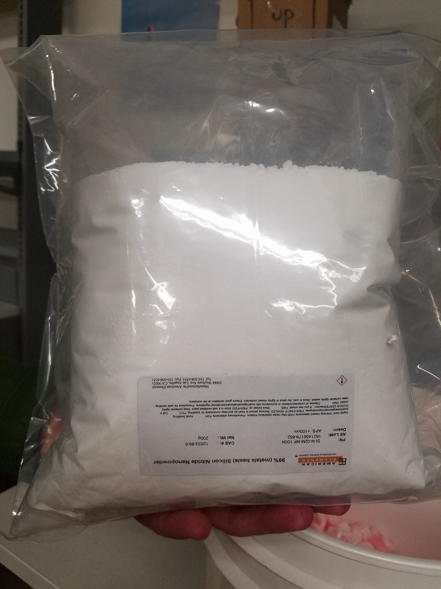
Project Description
Develop a practical “fluid” amplifier for use in a magnetostrictive torque actuator.
  Match body and “fluid” coefficients of thermal expansion
  Ensure no stroke hysteresis
  Maximize output amplification (10:1 minimum)
Research-based project
Nicole Mitich
3/8/17
Team 29: Honeywell Powder Amplifier

Slide 3
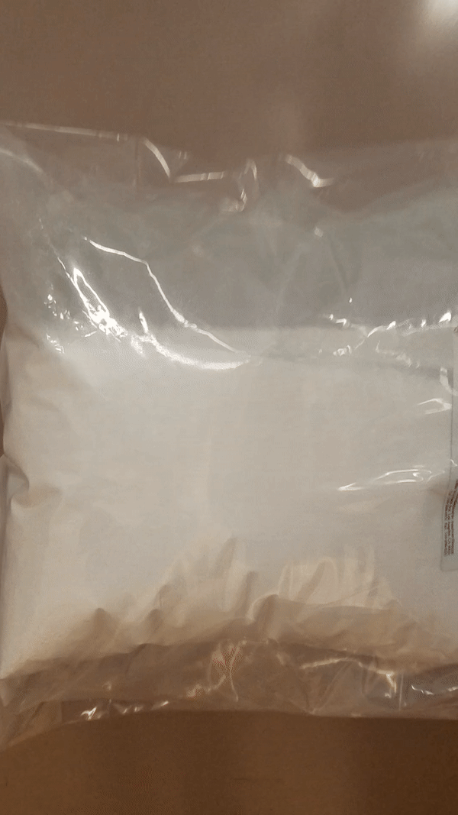
Updates
Ordered and received Dynalene HC-50 hydraulic fluid and SiN nanoparticles
Received 2015-2016 magnetostrictive actuator prototype
Ordered and received all thermal expansion testing equipment from McMaster-Carr
Calibrated thermal expansion experimental setup using standard liquids
No manufacturing required!
Savana Bezdicek
3/8/17
Team 29: Honeywell Powder Amplifier

Slide 4
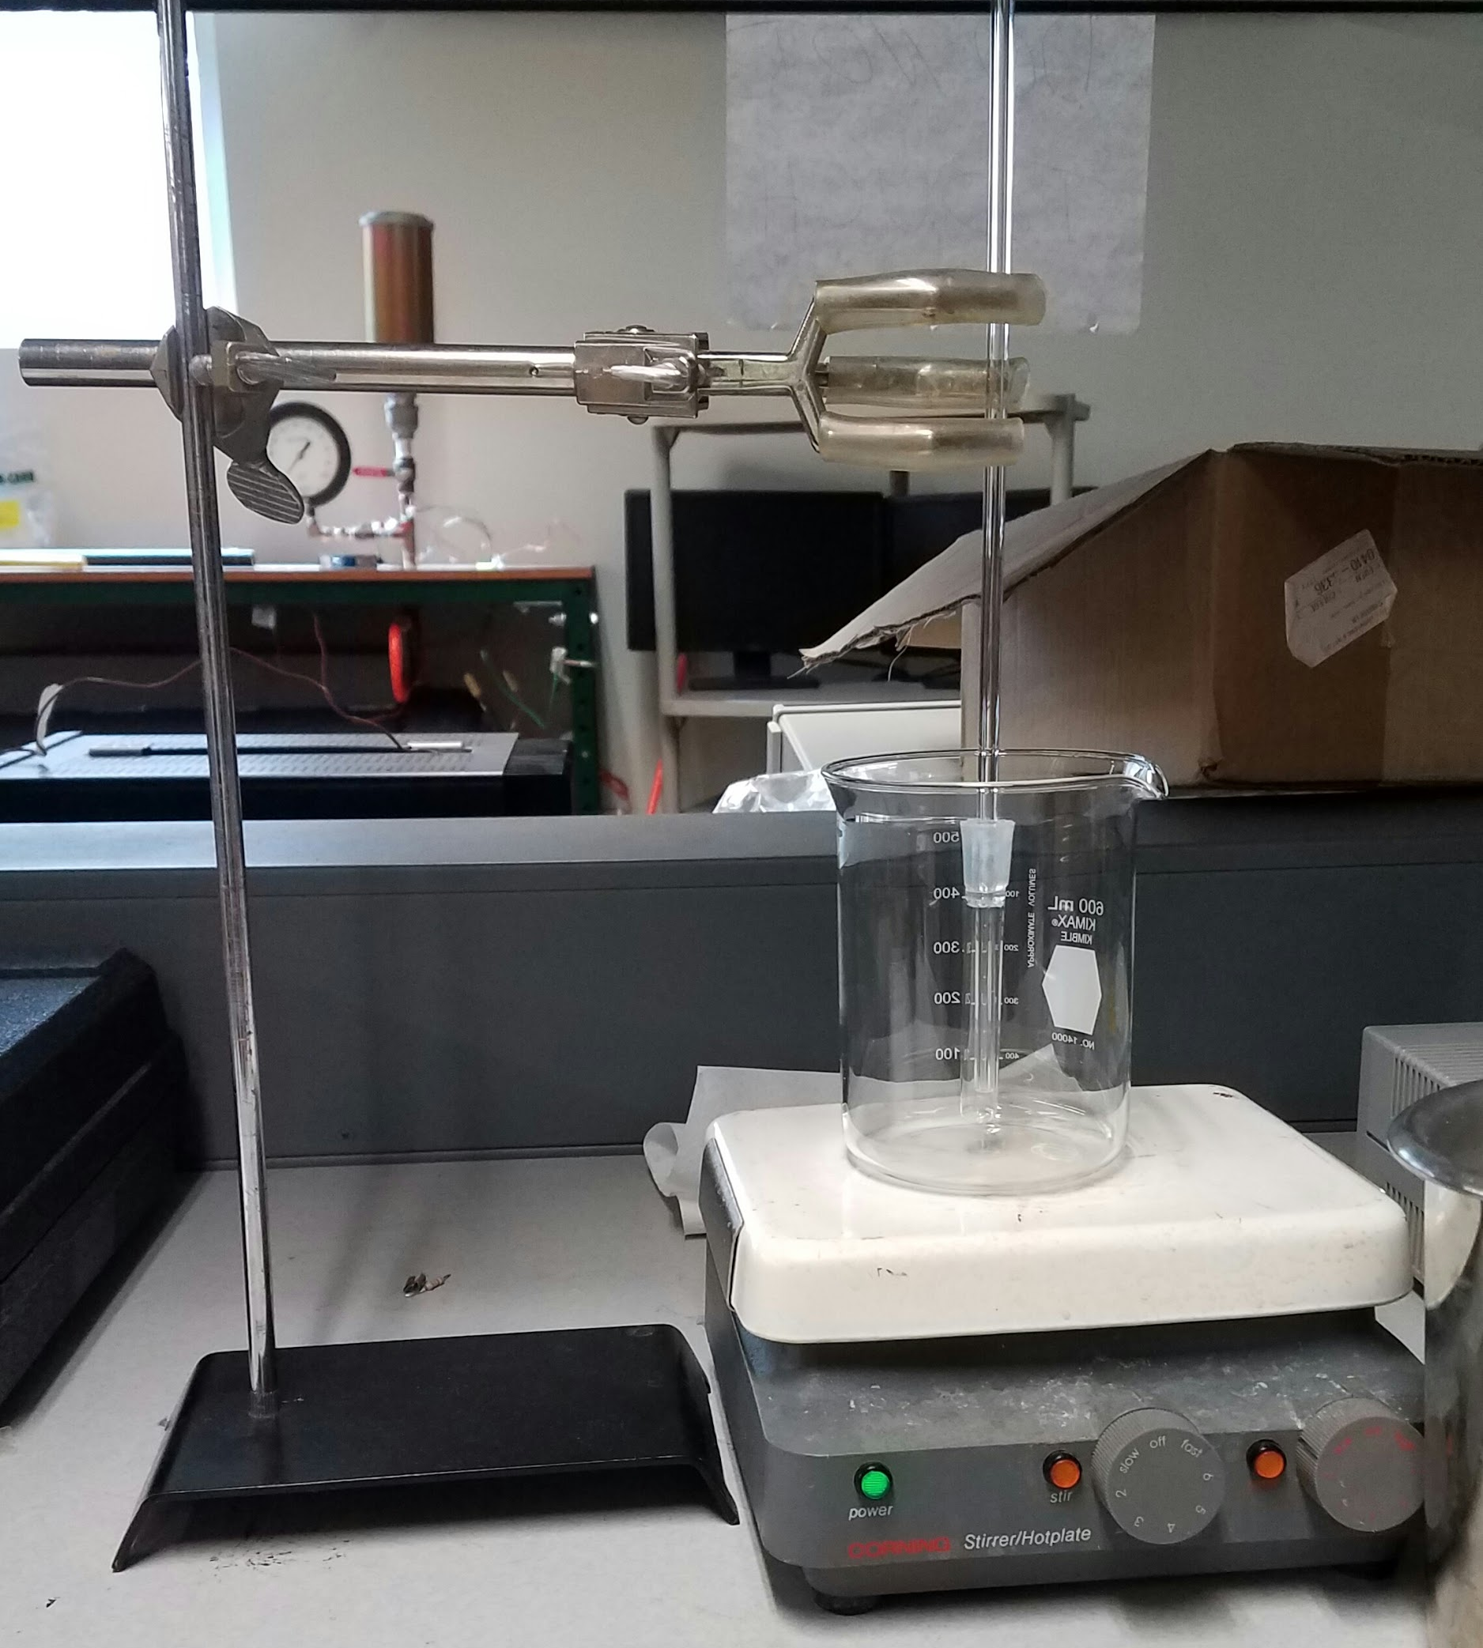
Moving Forward - Thermal Expansion Testing
VI with K-Type Thermocouple
  Monitors water bath temperature to ensure accurate temperature reading
5 mL test tube filled completely with nanofluid
  Presence of air produces inaccuracies in expansion
High purity rubber stopper with hole for borosilicate tube
  Bottom of tube placed precisely at bottom of stopper
Hot plate to provide heat
Jacob Setzer
3/8/17
Team 29: Honeywell Powder Amplifier

Slide 5
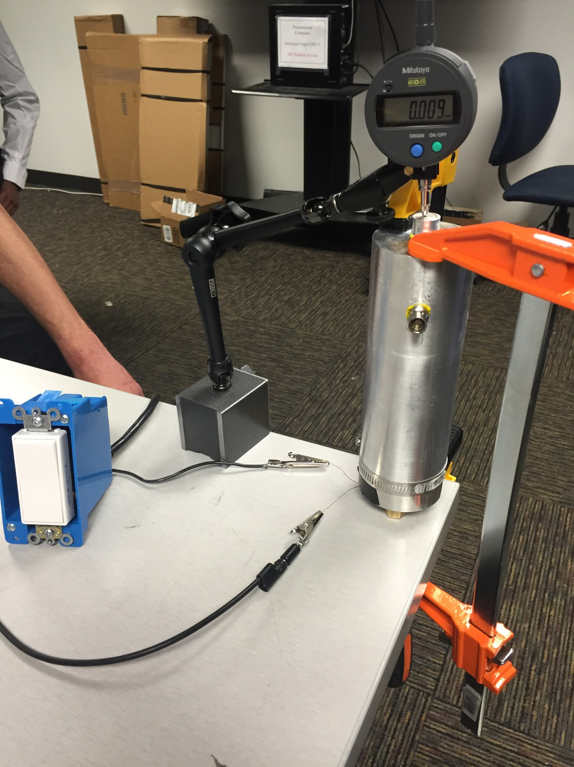
Moving Forward - Output Amplification/Hysteresis Testing
2015-2016 actuator prototype
Digital micrometer
  Monitors small changes in output
Bar clamps
  Ensure actuator remains fixed upon activation
DC power supply
Actuator will be tested with two amplifier conditions separately: empty and with nanofluid
Nicole Mitich
3/8/17
Team 29: Honeywell Powder Amplifier

Slide 6
Responsibilities
Thermal Expansion Testing
Nicole: Thermal expansion testing procedure
Jacob and Isaac: VI creation and thermocouple calibration / material ordering
Savana: Standard liquid obtainment
Luke: Analysis
Stroke Hysteresis/Output Amplification Testing
Savana: Stroke hysteresis and output amplification testing procedures
Luke: Experimental setup
Nicole: Material ordering
Jacob: Data acquisition
Isaac: Analysis
Isaac Romero
3/8/17
Team 29: Honeywell Powder Amplifier

Slide 7
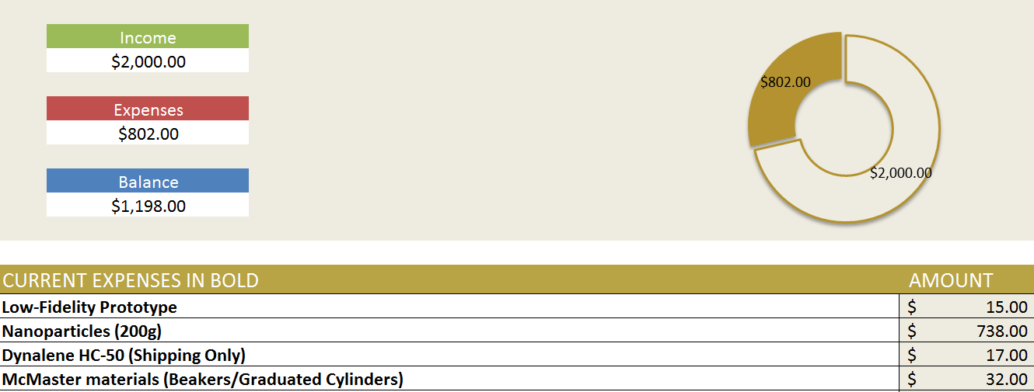
Budget
Luke Plumb
3/8/17
Team 29: Honeywell Powder Amplifier

Slide 8
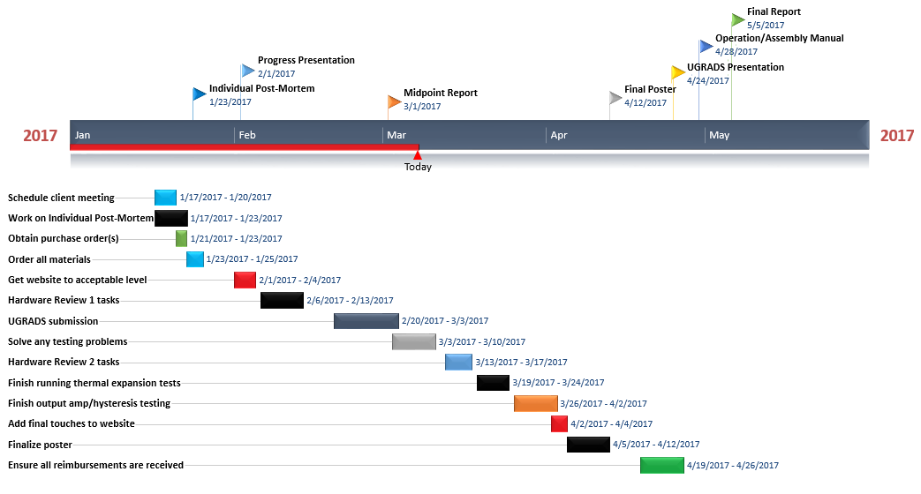
Schedule
Isaac Romero
3/8/17
Team 29: Honeywell Powder Amplifier

